Slide 1



HOSPITAL ANALYSIS USING SQL

Slide 2



ABOUT ME
Hello, my name is riya sengar and in this project i have utilised sql query to solve questions that was related to patients in hospital.

Slide 3

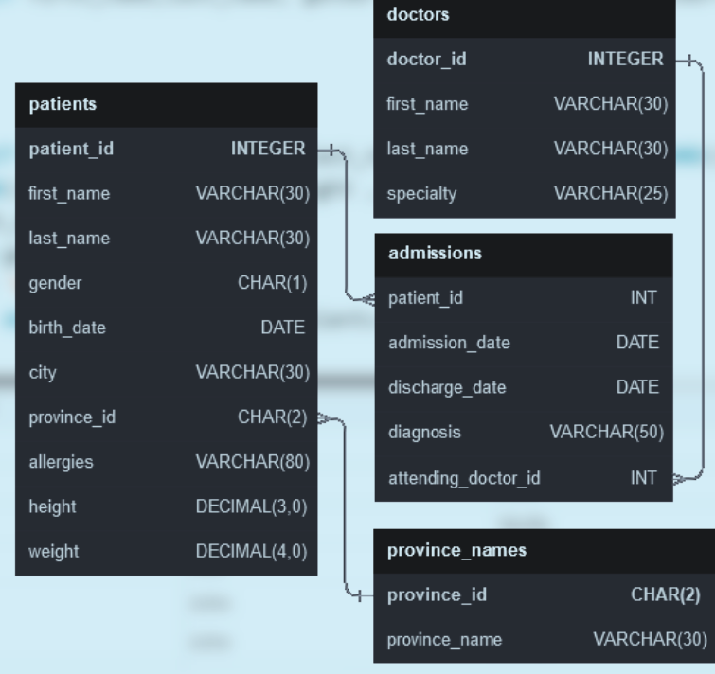

SCHEMA

Slide 4


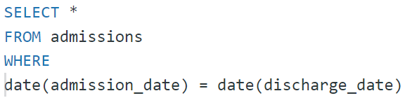
Show all the columns from admissions where the patient was admitted and discharged on the same day.

Slide 5


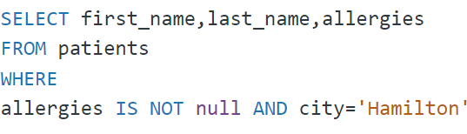
Write a query to find list of patients first_name, last_name, and allergies where allergies are not null and are from the city of 'Hamilton'.

Slide 6

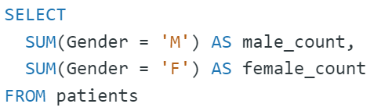

Show the total amount of male patients and the total amount of female patients in the patients table. Display the two results in the same row.

Slide 7

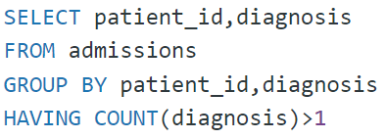
Show patient_id, diagnosis from admissions. Find patients admitted multiple times for the same diagnosis.

Slide 8

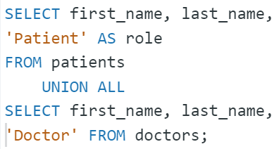

Show first name, last name and role of every person that is either patient or doctor.
The roles are either "Patient" or "Doctor"

Slide 9

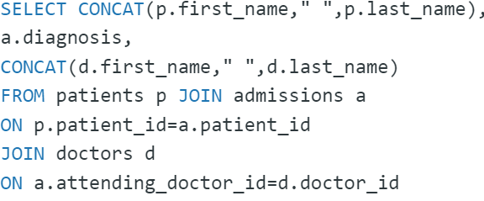
For every admission, display the patient's full name, their admission diagnosis, and their doctor's full name who diagnosed their problem.

Slide 10
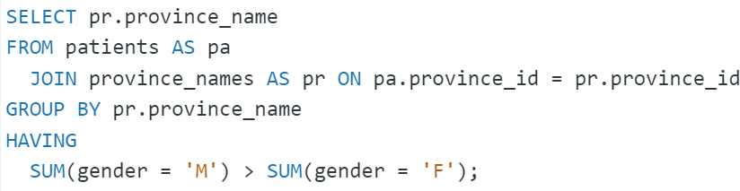
Show the provinces that has more patients identified as 'M' than 'F'. Must only show full province_name.

Slide 11
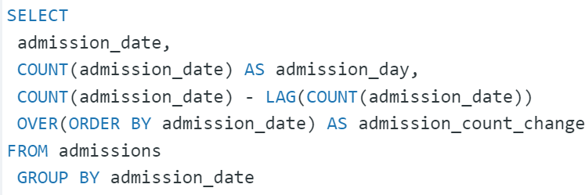
For each day display the total amount of admissions on that day. Display the amount changed from the previous date.

Slide 12
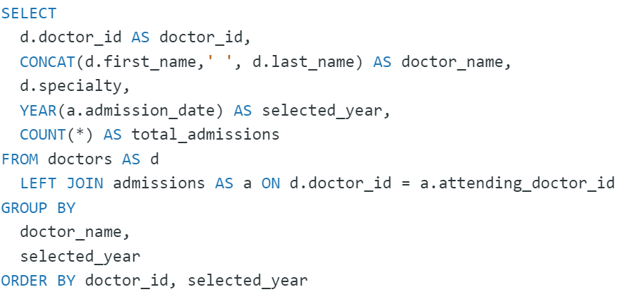
We need a breakdown for the total amount of admissions each doctor has started each year. Show the doctor_id, doctor_full_name, specialty, year, total_admissions for that year.

Slide 13
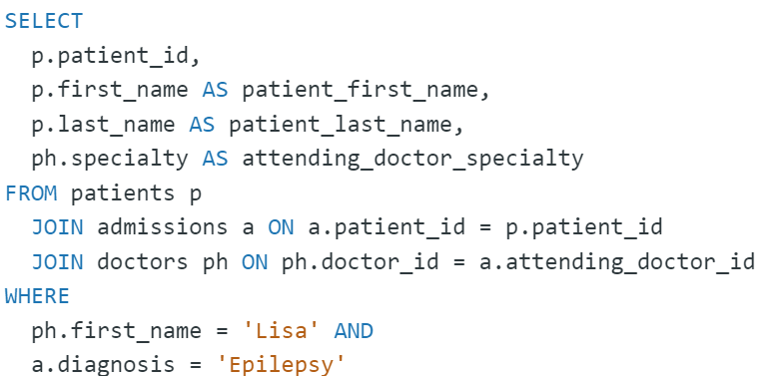
Show patient_id, first_name, last_name, and attending doctor's specialty.Show only the patients who has a diagnosis as 'Epilepsy' and the doctor's first name is 'Lisa’
Check patients, admissions, and doctors tables for required information.

Slide 14
THANK YOU

